Slide 1
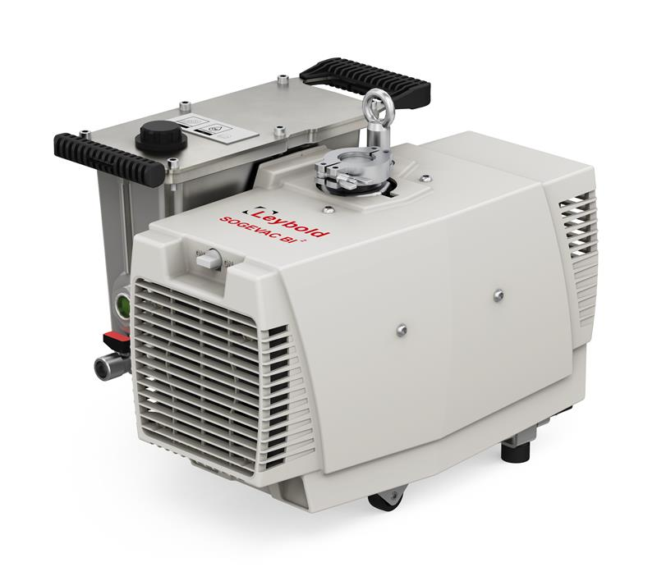
SOGEVAC
SV 55 BI²
SV 70 BI²
L. Furrer
Valence, Jan. 2025

Slide 2
Agenda
Pump range
Your advantages
Vacuum generator & drive design
Oil casing & exhaust filter design
Dimension comparison
Performance
Interfaces
Packaging

Slide 3





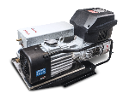
SOGEVAC - Product range SV 16 DI - 120 BI FC
Present product range
SV 16 DI |  | Ultimate pressure 0.10 mbar Big oil volume 2.0 l Single phase motor 100 V, 115 V & 200 V … 240 V +- 10 %; 50 & 60 Hz
SV 28 BI |  | Ultimate pressure 0.05 mbar Big oil volume 1.5 l Single phase motor 200 V … 240 V +- 10 %; 50 & 60 Hz
SV 40 BI (FC) |  | Ultimate pressure 0.15 mbar Single phase motor 200 V … 240 V +- 10 %; 50 & 60 Hz or frequency converter
SV 65 BI FC |  | Ultimate pressure 0.15 mbar Frequency converter 200 V … 240 V +- 10 %; 50 & 60 Hz Effective pumping @ 2 mbar > 50 m3/h
SV 120 BI FC |  | Ultimate pressure 0.15 mbar Frequency converter 200 V … 240 V +- 10 %; 50 & 60 Hz Effective pumping @ 2 mbar up to 110 m3/h With caster & handles for easy movement!
Present project Phase 1
Phase 2

Slide 4

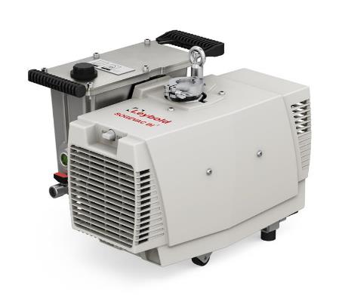







SOGEVAC SV 55 / 70 BI²
Your advantages
Adjustable pumping speed
Easier integration, less floor space & HSE risk reduction:
Smaller size, mobility & lighter pump
Monitoring & preventive maintenance:
On board intelligence & IoT readiness
Increased reliability & peace of mind operation:
No more external shaft seals!
CO₂ foot-print reduction:
Min. 20 % power savings & lower weight
Happy users & lower costs:
Aiming for 54 dB(A) noise level. No need of noise enclosures!
Clean & easy maintenance:
New oil & filter change concept
New packaging w/o screws through the pallet
HSE risk reduction & easier & quicker unpackaging

Slide 5
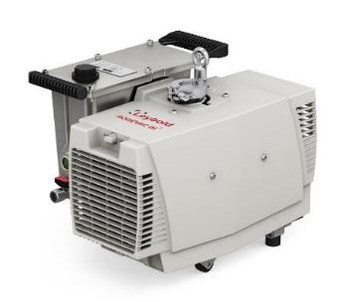

SOGEVAC SV 70 BI²
Your Value in Euro vs. SV65 BI FC
Topic | Savings / pump / year | Savings / occurrence | Remark
Power savings 70 size | 2400 kVA / pump 2400 kVA / air conditioning 4800 kVA = 960.- Euro |  | 8000 h 300 VA average reduction + twice for air conditioning but half time only. 0,2 Euro / kVA
Lighter pump – 30 kg | Approx. 100.- Euro |  | Euro 3.- / kg air freight
Smaller package – 50 % | Approx. 30.- Euro |  | Twice more pumps / surface
Faster unpacking & start-up | Euro 15.- |  | 10 minutes gain Euro 100.- / h FSE rate
Shorter maintenance | Euro 15.- |  | 10 minutes gain Euro 100.- / h FSE rate
1 l less oil (50 % reduction) | Euro 60.- |  | on 70 size average selling price
Monitoring & preventive maintenance |  | Euro 2000.- / issue | Less Quality costs. Remote assessments possible w/o travelling
Increased reliability |  | Euro 4000.- / issue | Costs for pump exchange Less pump exchanges thanks to no more external shaft seals!
Low noise level: no need for noise enclosure |  | Euro 1300.- / noise enclosure | Our enclosures are cheaper ;)
Total Euro | 1180.- in first year 1035.- each following year

Slide 6
SOGEVAC SV 55 BI²
Your Value in Euro vs. SV40 BI (FC)
Topic | Savings / pump / year | Savings / occurrence | Remark
Power savings 55 size | 1200 kVA / pump 1200 kVA / air conditioning 2400 kVA = 480.- Euro |  | 8000 h 150 VA average reduction + twice for air conditioning but half time only. 0.20 Euro / kVA
Lighter pump – 18 kg | Approx. 50.- Euro |  | Euro 3.- / kg air freight
Smaller package – 50 % | Approx. 30.- Euro |  | Twice more pumps / surface
Faster unpacking & start-up | Euro 15.- |  | 10 minutes gain Euro 100.- / h FSE rate
Shorter maintenance | Euro 15.- |  | 10 minutes gain Euro 100.- / h FSE rate
Monitoring & preventive maintenance |  | Euro 2000.- / issue | Less Quality costs. Remote assessments possible w/o travelling
Increased reliability |  | Euro 4000.- / issue | Costs for pump exchange Less pump exchanges thanks to no more external shaft seals!
Low noise level: no need for noise enclosure |  | Euro 1300.- / noise enclosure | Our enclosures are cheaper ;)
Total Euro | 590.- in first year 495.- each following year

Slide 7
SOGEVAC SV 55 BI² vs. 28 BI
Your Value in Euro
Topic | Savings / pump / year | Savings / occurrence | Remark
Power savings 55 size | 1000 kVA / pump 1000 kVA / air conditioning 2000 kVA = 400.- Euro |  | 8000 h 150 VA average reduction + twice for air conditioning but half time only. 0.20 Euro / kVA
Lighter pump – 12 kg | Approx. 40.- Euro |  | Euro 3.- / kg air freight
Smaller package – 50 % | Approx. 30.- Euro |  | Twice more pumps / surface
Faster unpacking & start-up | Euro 15.- |  | 10 minutes gain Euro 100.- / h FSE rate
Shorter maintenance | Euro 15.- |  | 10 minutes gain Euro 100.- / h FSE rate
0,5 l less oil (33 % reduction) | Euro 60.-
Monitoring & preventive maintenance |  | Euro 2000.- / issue | Less Quality costs. Remote assessments possible w/o travelling
Increased reliability |  | Euro 4000.- / issue | Costs for pump exchange Less pump exchanges thanks to no more external shaft seals!
Low noise level: no need for noise enclosure |  | Euro 1300.- / noise enclosure | Our enclosures are cheaper ;)
Total Euro | 560.- in first year 475.- each following year

Slide 8
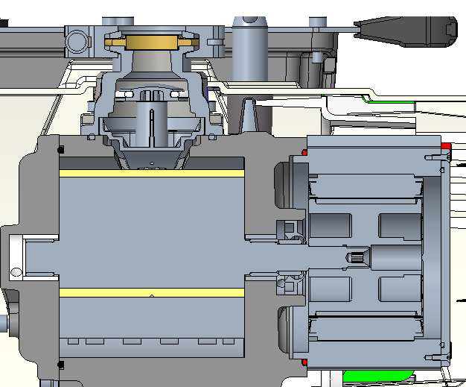

SOGEVAC SV 55 / 70 BI²
Generator & drive: no more shaft seals & IE5 PM motor
Increased reliability (especially for ICPMS)
Extended pump overhaul time (especially for ICPMS)
SHE improvement
  No more shaft seal oil leaks
  Mobility
  Easy unpacking w/o lifting
  Quieter
IE5 drive train efficiency: the top!
Downsizing & weight reduction
  Bench integration easier
  Less need of expensive & big noise enclosures
  Less Lab floor space required
  Smaller packaging less storage & transportation costs
Tight vacuum generator
No shaft seals!

Slide 9
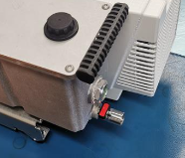
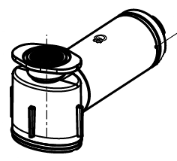
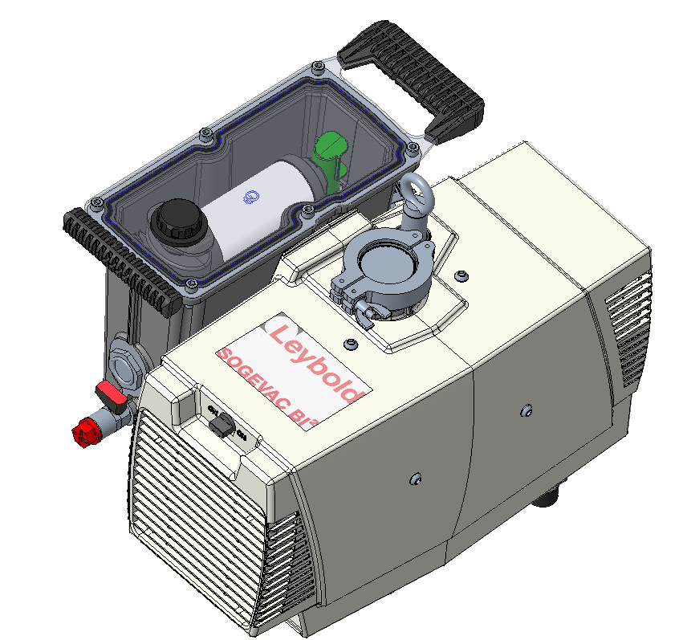
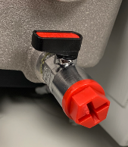
SOGEVAC SV 55 / 70 BI²
Oil casing & Maintenance
Patented exhaust filter
Leybonol 702 or PFPE
Oil volume 1 l for both sizes
Higher oil drain valve for easier oil draining
Oil drain valve standard, much higher vs. floor
Drain hose available as accessory
No more 12 mm hex key
Oil filling plug on oil casing cover
Maintenance done in 10 minutes only!
10 minutes gain

Slide 10
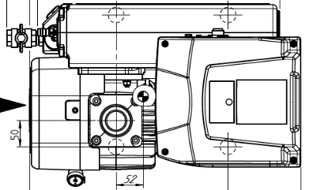
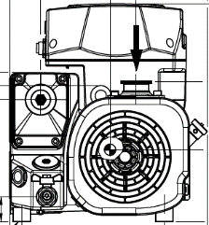
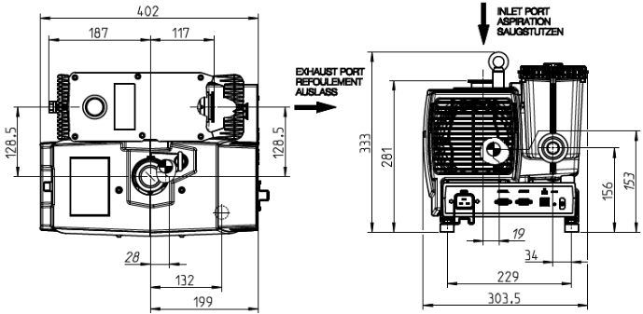
SOGEVAC SV 55 / 70 BI²
Dimensions vs. 65 BI FC
SV 65 BI FC | SV 70 BI² | Reduction
76 l volume | 41 l volume | 35 l / 46%
Net weight 57 kg | Net weight 31 kg | 26 kg / 46 %
386
560
352
SV 70 BI² footprint just smaller than an A3 sheet

Slide 11
SOGEVAC SV 55 / 70 BI²
Dimensions vs. 40 BI FC
SV 40 BI FC | SV 55 BI² | Reduction
71 l volume | 41 l volume | 30 l / 42%
Net weight 45 kg | Net weight 30 kg | 15 kg / 33 %
386
560
330
SV 55 BI² footprint just smaller than an A3 sheet

Slide 12
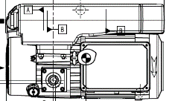
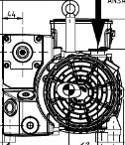
SOGEVAC SV 30 / 55 / 70 BI²
Dimensions vs. 28 BI FC
SV 28 BI | SV30 BI² | Reduction
33 l volume | 41 l volume | - 8 l / - 24%
Net weight 39 kg | Net weight 30 kg | 9 kg / 23 %
301
423
258

Slide 13
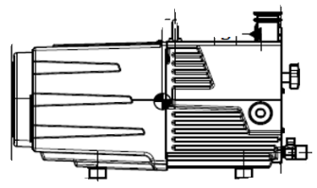
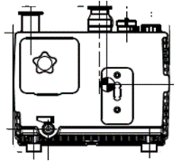
SOGEVAC SV 55 / 70 BI²
Dimensions vs. 16/25 D(I)
SV 16/25 D(I) | SV 55 BI² | Reduction
31 l volume | 41 l volume | - 10 l / - 32%
Net weight 25 kg | Net weight 30 kg | - 5 kg / - 20 %
259
440
268

Slide 14
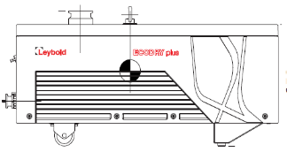
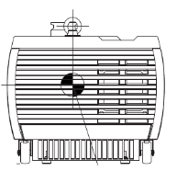
SOGEVAC SV 55 / 70 BI²
Dimensions vs. ECODRY 65+
ECODRY 65+ | SV 70 BI² | Reduction
57 l volume | 41 l volume | 16 l / 28%
Net weight 43 kg | Net weight 31 kg | 12 kg / 28 %
298
600
320

Slide 15
SOGEVAC SV 55 / 70 BI²
Pumping speed performance sizes 65/70 LVO702
Similar pumping speed curve as today
Inlet pressure cont. duty max. 10 mbar
Speed | Rpm | Frequency | Typical Pump speed
 |  | Hz | m3/h
Min | 900 | 15 | 33
Rated | 1500 | 25 | 55
Max | 1650 | 27,5 | 60
SV 70 BI²
SV 65 BI FC

Slide 16
SOGEVAC SV 55 / 70 BI²
Pumping speed performance sizes 40/55 LVO702
Similar pumping speed curve as today in working zone
Inlet pressure cont. duty max. 10 mbar
Speed | Rpm | Frequency | Typical Pump speed
 |  | Hz | m3/h
Min | 900 | 15 | 28
Rated | 1500 | 25 | 46
Max | 1650 | 27,5 | 50
SV 55 BI²
SV 40 BI FC

Slide 17
SOGEVAC SV 55 / 70 BI²
Pumping speed performance sizes 40/55 PFPE
Similar pumping speed curve as today
Inlet pressure cont. duty max. 10 mbar
Speed | Rpm | Frequency | Typical Pump speed
 |  | Hz | m3/h
Min | 900 | 15 | 26
Rated | 1500 | 25 | 44
Max | 1650 | 27,5 | 48
SV 55 BI²
SV 40 BI FC

Slide 18
SOGEVAC SV / BI²
Power W | SV28 BI | SV55 BI² | Difference
1 mbar | 600 | 490 | - 110 W / - 18 %
2,5 mbar | 640 | 510 | - 130 W / - 20 %
10 mbar | 710 | 580 | - 130 W / - 18 %
Power consumption sizes 40/55 resp. 65/70
Power W | SV40 BI | SV55 BI² | Difference
1 mbar | 610 | 490 | - 120 W / - 20 %
2,5 mbar | 640 | 510 | - 130 W / - 20 %
10 mbar | 760 | 580 | - 180 W / - 24 %
Power W | SV65 BI | SV70 BI² | Difference
1 mbar | 770 | 470 | - 300 W / - 39 %
2,5 mbar | 800 | 490 | - 310 W / - 38 %
10 mbar | 930 | 600 | - 330 W / - 35 %
Reduced CoO & CO₂ footprint
Inrush current < 7 A! No breaker tripping when pump in energized

Slide 19
SOGEVAC SV 55 / 70 BI²
Line current & Power consumption at 2,5 mbar – LVO702
Pump Size | Line Current SV BI [A] | Line Current SV BI² [A] | Difference %
40 / 55 | 4,6 | 2,3 | - 50%
65 / 70 | 6,0 | 2,3 | - 62%
Reduced current & power consumption at 2,5 mbar thanks to active power factor compensation
Benchmark, even for dry pumps
Reduced CoO
Same power savings for air conditioning units
Inrush current < 7 A !

Slide 20
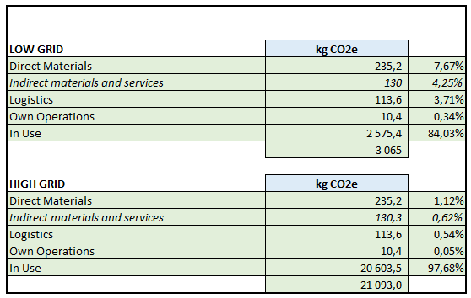
SOGEVAC SV 55 / 70 BI²
CO₂e footprint
Reduced CO₂e footprint thanks to
Lightweight construction
Local suppliers
Low energy consumption
100 % renewable electricity in Valence factory
Electricity Low grid (kgCO2e/kWh) | 0,1
Electricity High grid (kgCO2e/kWh) | 0,8

Slide 21
SOGEVAC SV 55 / 70 BI²
Performance
Performance comparison SOGEVAC BI vs BI²:
same vacuum performance
lower power consumption
Description | Unit | SV28 BI | SV40 BI FC | SV55 BI² |  | SV 65 BI FC | SV70 BI²
Volumetric flow rate 50 Hz | m³/h | 25 | 50 | 55 |  | 71 | 71
Volumetric flow rate 60 Hz | m³/h | 30 | 50 | 50 |  | 71 | 71
Effective pumping speed 50 Hz at 2 mbar | m³/h | 23 | 36 | >40 |  | 50 | >50
Effective pumping speed 60 Hz at 2 mbar | m³/h | 25 | 36 | >40 |  | 50 | >50
Ultimate total pressure without gas ballast | mbar(a) | 0,05 | 0,2 | 0,2 |  | 0,2 | 0,2
Ultimate total pressure with open gas ballast std | mbar(a) | 0,5 | 1 | 1 |  | 1 | 1
Water vapor tolerance gas ballast std 50 Hz | mbar(a) | 10 | 10 | 10 |  | 10 | 10
Water vapor tolerance gas ballast std 60 Hz | mbar(a) | 10 | 10 | 10 |  | 10 | 10
Water vapor capacity gas ballast std 50 Hz | l/h | 0,07 | 0,34 | 0,34 |  | 0,42 | 0,42
Water vapor capacity gas ballast std 60 Hz | l/h | 0,08 | 0,34 | 0,34 |  | 0,42 | 0,42
Nominal motor power 50 Hz | kW | 0,55 / 0,9 | 1,5 | 0,75 |  | 1,5 | 0,75
Nominal motor power 60 Hz | kW | 0,66 / 1,1 | 1,5 | 0,75 |  | 1,5 | 0,75
Mean sound pressure level at 1 m distance 50 Hz 1ph | dB(A) | 57 | 59 | 58 |  | 60 | 59
Mean sound pressure level at 1 m distance 60 Hz 1ph | dB(A) | 57 | 59 | 58 |  | 60 | 59
Rotor speed 50 Hz | rpm | 1500 | 1800 | 1500 |  | 1800 | 1500
Rotor speed 60 Hz | rpm | 1800 | 1800 | 1500 |  | 1800 | 1500
Oil capacity (min-max) | l | 1,5 | 1 | 1 |  | 2 | 1
Weight Net mass | kg | 37 | 45 | 30 |  | 56 | 31
Weight Total shipping mass | kg | 39 | 57 | 39 |  | 68 | 39
Flange |  | 25 KF | 25 KF / 40 KF | 25 KF / 40 KF |  | 40 KF | 25 KF / 40 KF

Slide 22
SOGEVAC SV 55 / 70 BI²
Limitations & standards
Limitations
Same as present pumps, operation up 3000 m w/o limitations
Standards & immunities
Same as present pumps
  UL/EN 61010-1 compliance
  EMC Class B
  Leakage current < 1,2 mA
  Etc.
 |  | SV28 BI | SV40 BI | SV55 BI² | SV65 BI | SV70 BI²
Maximum inlet pressure for continuous operation | mbar (abs) | 1013 | 10 | 10 | 10 | 10
Maximum ambient temperature | °C | 40 | 40 | 40 | 40 | 40
Minimum ambient temperature | °C | 15 | 18 | 18 | 18 | 18
Maximum gas inlet temperature | °C | 40 | 40 | 40 | 40 | 40
Minimum gas inlet temperature | °C | 15 | 18 | 18 | 18 | 18
Maximum exhaust line pressure | mbar (rel) | 150 | 150 | 150 | 150 | 150
Minimum exhaust line pressure | mbar (rel) | -50 | -50 | -50 | -50 | -50

Slide 23
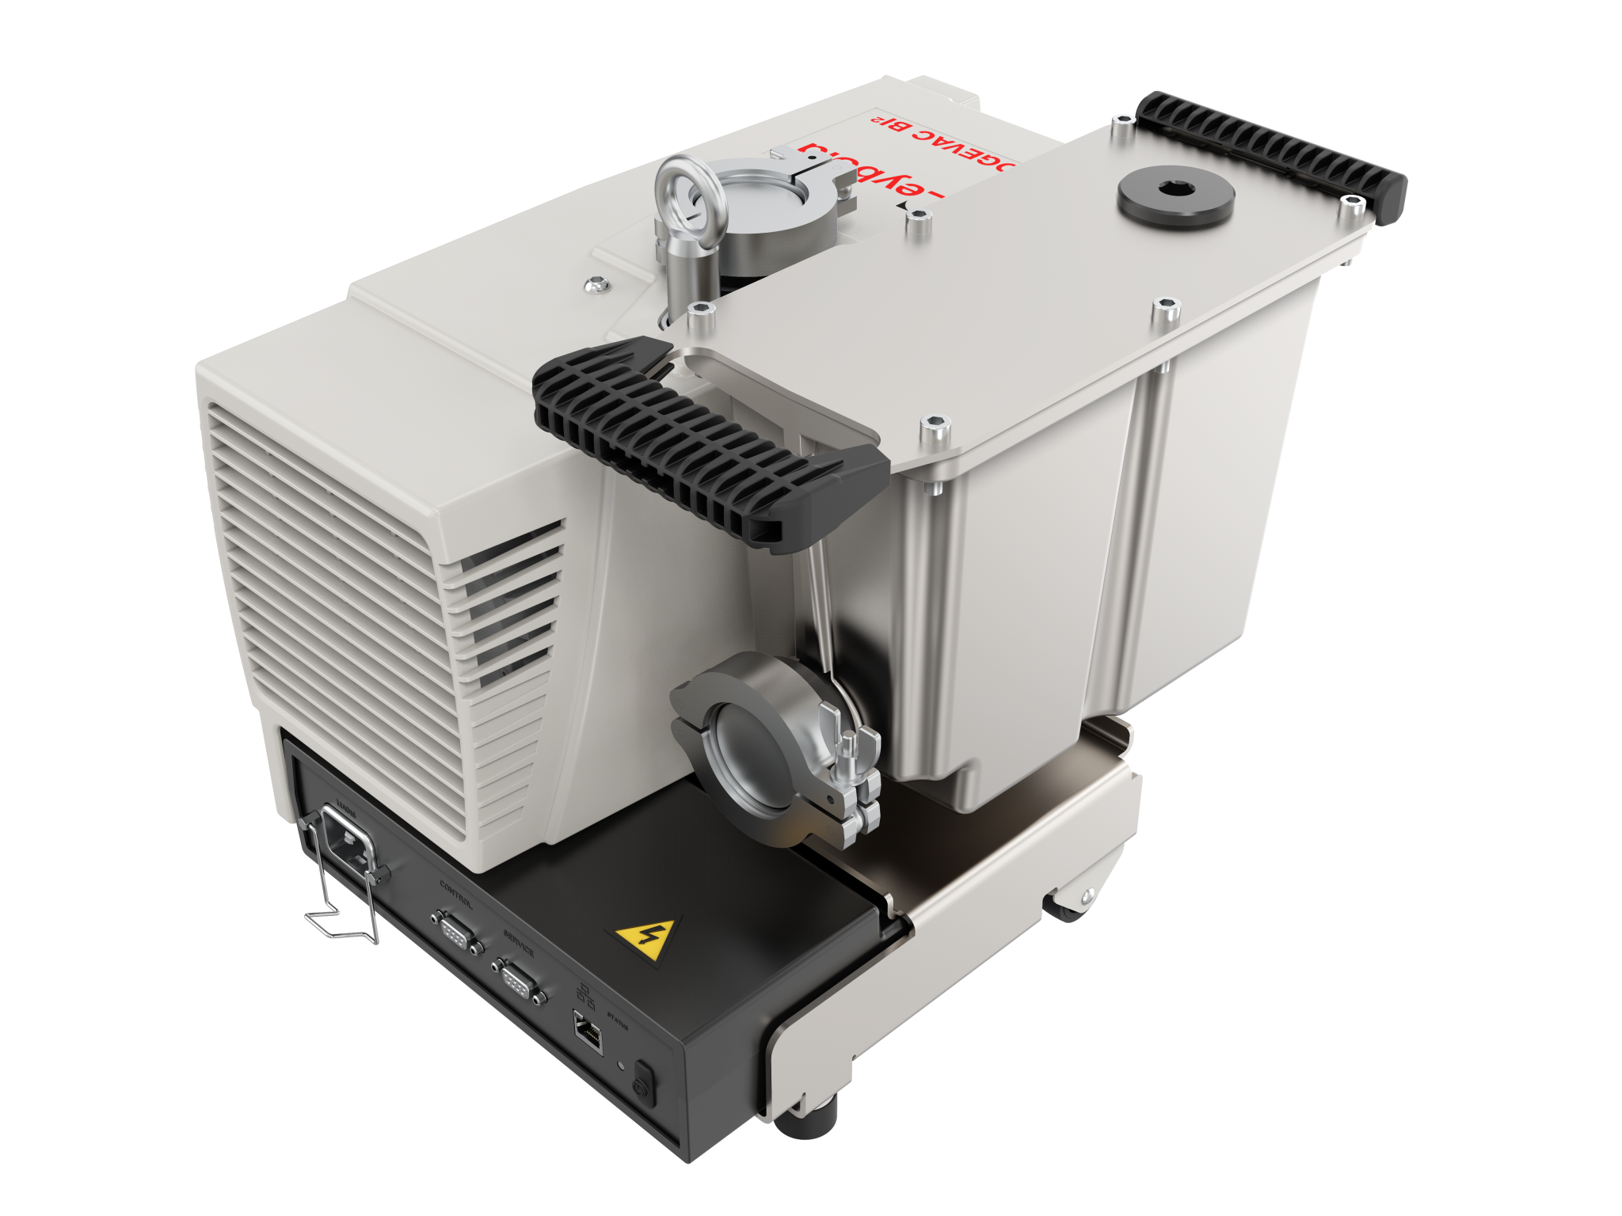
SOGEVAC SV 55 / 70 BI²
List of carried-out Tests
Category | Test
Performance | Pumping speed in f(inlet pressure)
 | Electrical power & current in f(inlet pressure)
 | Temperature in f(inlet pressure)
 | Noise level at ult pressure
 | Vibration level at inlet flange x/ y/ z displacement / speed / acceleration
 | Cold start
 | Pump down from atm to ult. pressure on a volume
 | ICPMS gas gulps (valve switching / dead volumes)
 | Inrush current
 | OCO and exhaust filter backpressure
 | Etc.
Compliance | Stability
EN/UL 61010-1 | Mechanical resistance, moving & lifting
 | Blocked exhaust
 | overspeed
 | Reverse rotation
 | Blocked pump start
 | Blocking pump in operation
 | Blocked cooling behavior
 | EMC Radiated / Conducted Class B
 | Immunities / Leakage current < 3.5 mA @ 264 V, 60 Hz
 | Packaging (ISTA 3B & internal tests)
 | Etc.
Reliability | HALT
 | Components qualification
 | Long duration tests
 | Oil loss monitoring
 | Oil quality monitoring
 | Etc.
Maintenance | Ease of oil draining & remaining oil volume
 | Ease of exhaust filter changing
 | Etc.
To avoid that our customers do “unnecessary” test (taking time & money), we list the main topics which are tested from our side
Our customers should concentrate on the process resistance, especially on ICPMS processes, which can’t be replicated in our factory

Slide 24
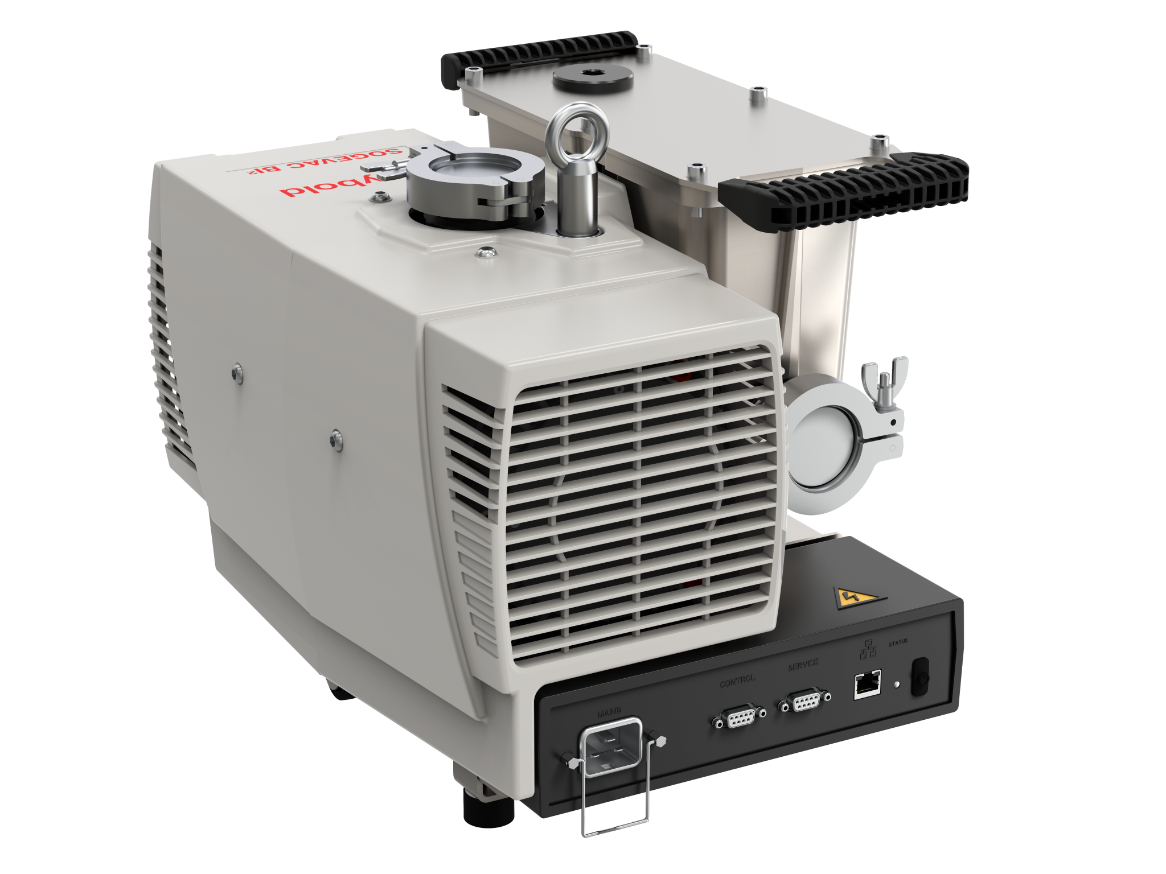
SOGEVAC SV 55 / 70 BI²
Interfaces
Standardization of:
C20 power socket with retention clip
Sub-D 9 female for Customer pump control
  RS485 / Modbus Dedicated address
  Analog signals (speed, On / Off) 24 V DC or dry switch
Sub-D 9 female for Leybold Service Leyassist
  Interface RS485 / Modbus Dedicated address
  With plastic red cover
RJ 45 for LAN & Cloud Genius connectivity & remote assistance
On/Off switch (which can enabled or disabled)

Slide 25
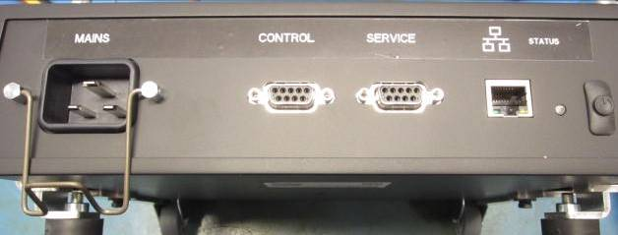
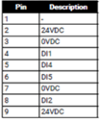

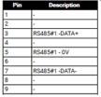

SOGEVAC SV 55 / 70 BI²
Interfaces
Standardization of:
Sub-D 9 female for Customer pump control
  RS485 / Modbus Dedicated address
  Same pin out as on present pumps with BlackBox drive
  or
  Analog signals (speed, On / Off) 24 V DC (Pin 8) & 0 V (Pin 7)
  NEW: Speed + or – allowing to adjust pump speed changes in increments connecting 2 & 5 (DI4 speed +) or 2 & 6 (DI5 speed -)
  As today : high speed 8 & 9 & idle mode with 2 or 9 & 4
Sub-D 9 female for Leybold Service Leyassist and Genius
  Interface RS485 / Modbus Dedicated address
  Genius box power supply
  Same pin location
RJ 45 for LAN & Cloud Genius connectivity & remote assistance
On/Off switch. Automatic restart after power failure. Switch can be disabled
1
2
3
4

Slide 26
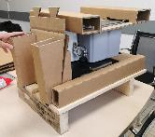
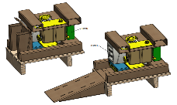
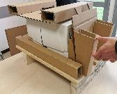
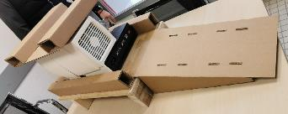
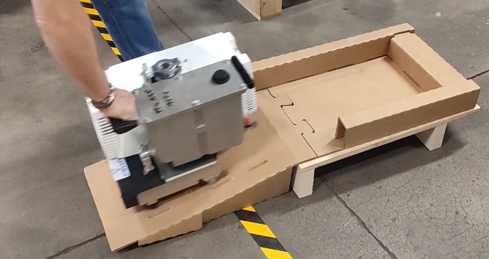
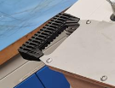

SOGEVAC SV 55 / 70 BI²
Packaging concept
Packaging
Wood palette & cardboard parts
Integrated roll-off ramp
ISTA 3B tests passed
Safe & easy installation
  no lifting
  no screws to be removed
  Oil casing handles to pull the pump

Slide 27
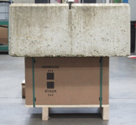
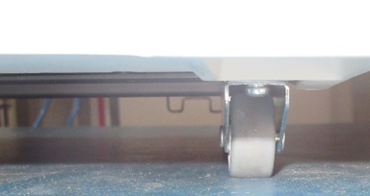
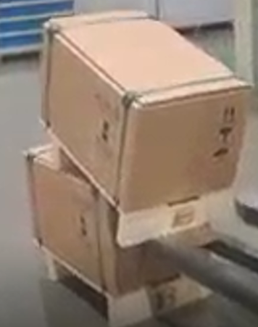
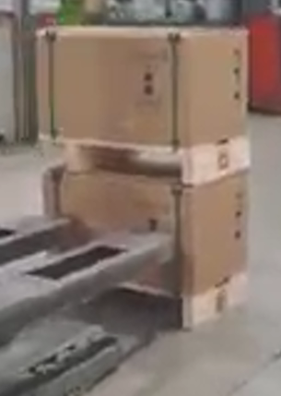
SOGEVAC SV 55 / 70 BI²
Packaging concept
Resistance to static load of 500 kg (13 pumps)
  No packaging damage
  No packaging deformation
  No pump damage or frame deformation
Same resistance as present (reinforced) SV40/65 BI packaging
Packaging & pump resists to brutal forklift ramming
  Video frontal: here
  Video lateral: here
Same packaging resistance as on present SV40/65 BI FC
(having foam inserts)

Slide 28
SOGEVAC SV 55 / 70 BI²
Packaging concept
Pump | Dimensions & volume | Gross weight kg
Present SV BI | 790 x 490 x 580 mm 225 l | 70
SV BI² | 600 x 400 x 453 mm 109 l | 39
Gain | 52 % | 44 %
Packaging
Reduced volume & weight
  Less freight charges
  More pumps in a container / truck
  Less storage volume & costs
  Easier transportation
  Upgraded resistance

Slide 29
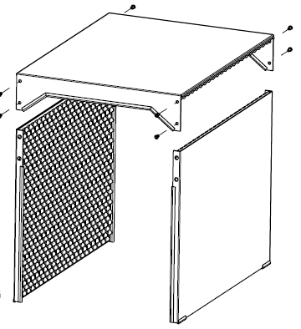

SOGEVAC SV 55 / 70 BI²
Accessories – Noise enclosure
A noise reduction enclosure without fan (natural convection) is available under P/N 960331NENC
Attenuations up to 5 dB(A)
Tunnel shape allows easy pump access & servicing.
The oil sight glass is visible from outside.
Light weight

Slide 30
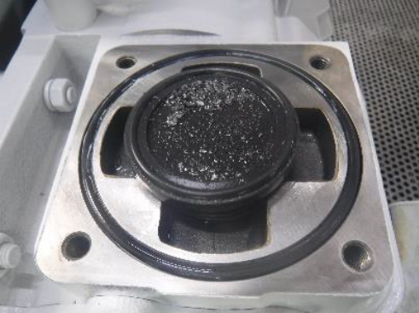
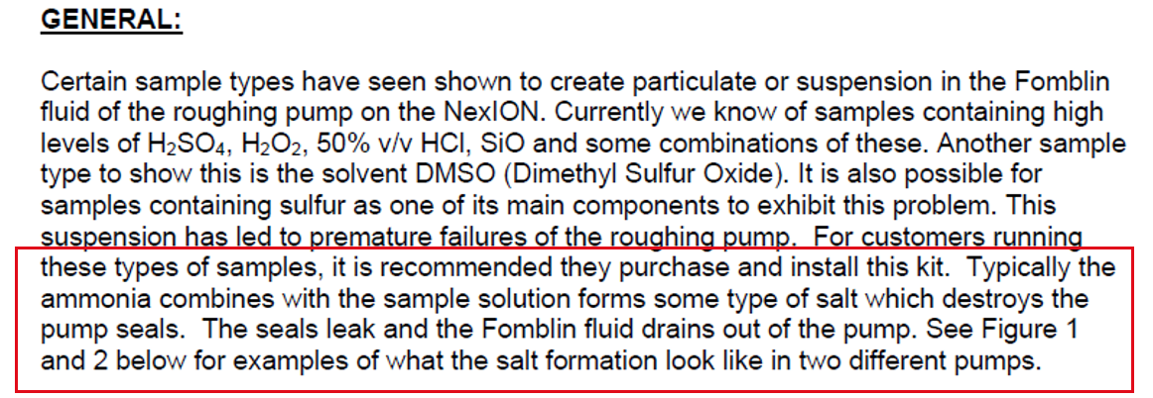
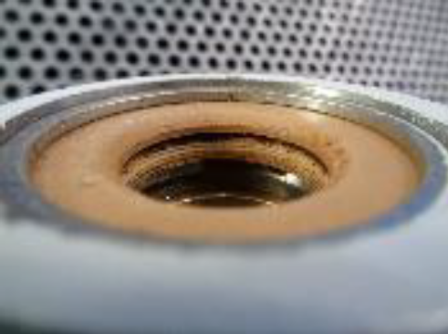
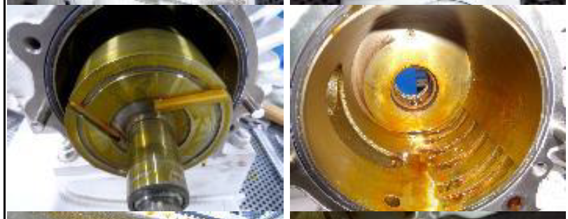
SOGEVAC SV 55 / 70 BI²
Accessories – ICPMS inlet protection
Some ICPMS processes create salt particles in the gas stream at the roughing pump inlet. These particles can create:
  Shaft seal leaks
  Oil backstreaming
  Milky PFPE
  Etc.

Slide 31
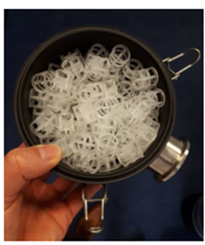

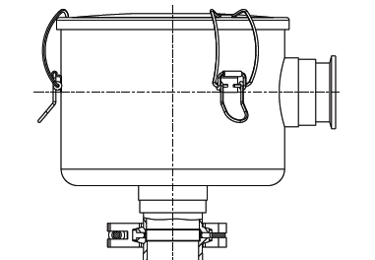
SOGEVAC SV 55 / 70 BI²
Accessories – ICPMS inlet protection – Raschig rings
Inlet protection with inlet filter & Raschig rings
Raschig rings will stop particles and oil vapor backstreaming
P/N 10330065A01 Inlet Filter 40-65 DN40KF Raschig
complete filter with Raschig rings
Spare Raschig rings filling (1,5 l) P/N G6562737

Slide 32
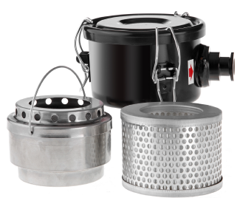
SOGEVAC SV 55 / 70 BI²
Accessories – ICPMS inlet protection - Zeolite
Inlet protection with inlet filter with zeolite
  P/N T189958 Zeolite Filter Kit
  complete filter with Zeolite
  P/N 85420 Zeolite, 1 kg (Spare)

Slide 33
SOGEVAC SV 55 / 70 BI²
Pump Protection
Mesure | Protection | Warning level | Err level [Shut down] | Name | Code | Description
Temperature | Motor windings PTO |  | 130°C | ERR_MOTOR_OVER_HEAT | 0x00000200 | Motor winding temperature too high
 | Pump PTC | 80 °C | 90 °C | ERR_PUMP_OVER_HEAT | 0x00000100 | Based on CTTR3_TEMP_THRES
 | Drive IGBT | 75 °C | 90 °C | ERR_IGBT_OVER_HEAT | 0x00000020 | IGBT temperature too high
 | Drive PFC | 75 °C | 90 °C | ERR_PFC_OVER_HEAT | 0x00000040 | PFC temperature too high
 | Drive PCB | 75 °C | 90 °C | ERR_PCB_OVER_HEAT | 0x00000080 | PCB temperature too high
Voltage | AC supply voltage | < 180 V | < 162 V | ER_UNDER_VOLTAGE_AC | 0x00000010 | AC voltage too low
 | AC supply voltage | > 264 V | > 290 V | ERR_OVER_VOLTAGE_AC | 0x00000008 | AC voltage too high
 | DC voltage | < 255 V | < 229 V | ERR_UNDER_VOLTAGE_DC | 0x00000004 | DC voltage too low
 | DC voltage | > 435 V | > 450 V | ERR_OVER_VOLTAGE_DC | 0x00000002 | DC voltage too high
 | FC |  | 24 +/- 5% | ERR_24V_FAILURE | 0x00004000 | Cannot deliver correct supply voltage to CTTR1/CTTR2/CITF
Current Error Adress register : 2100
Current Warning Adress Register : 2010

Slide 34
SOGEVAC SV 55 / 70 BI²
Software protection
Part | Name | Code | Description
Motor | ERR_OVER_CURRENT | 0x00000001 | Overcurrent trip of the motor drive triggered
 | ERR_U_PHASE | 0x00000800 | Inconsistent motor current on phase U
 | ERR_V_PHASE | 0x00001000 | Inconsistent motor current on phase V
 | ERR_W_PHASE | 0x00002000 | Inconsistent motor current on phase W
 | ERR_STEP_UP_OVERLOAD | 0x00200000 | Detection of a start at atmospheric pressure
Pump | ERR_OVERLOAD | 0x00000400 | I²t action integral trip triggered by prolonged motor overload
 | ERR_HARSH_CONDITIONS_TI MEOUT | 0x00040000 | Motor control FSM ran in HARSH CONDITIONS RUN for too long
 | ERR_HARSH_CONDITIONS_CYCLE | 0x00100000 | Clogged exhaust
FC | ERR_PLL_LOCK_LOSS | 0x00080000 | Motor control algorithm lost PLL lock after successful start-up

Slide 35

SOGEVAC SV 55 / 70 BI²
Communication
Details about pump communication parameters RS485
Correlation with SV65 BI FC BlackBox drive

