Slide 2
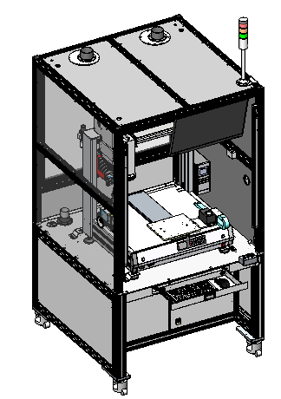

Slide 3
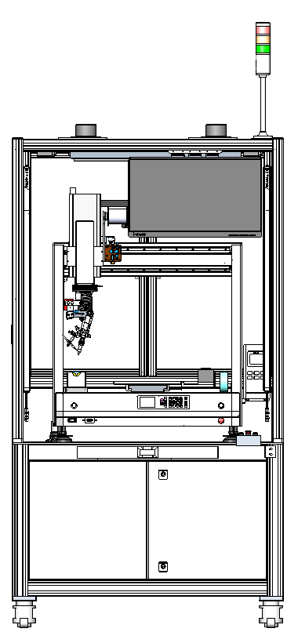
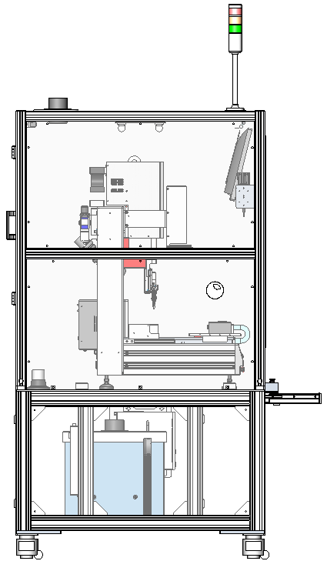
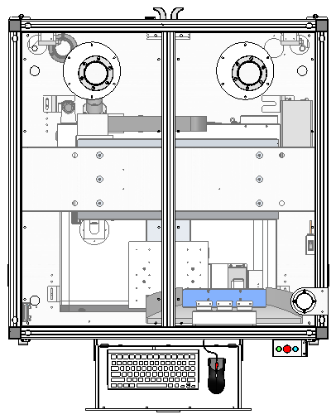
Dimensions Diagram
01
Distance between soldering iron and Y-axis platform is around 100mm
2230mm
1800mm
Distance between ground and Y-axis platform is around 900mm
1000mm
Note:
The size of the equipment is only the reference size of the scheme, and the actual size shall prevail after optimization
1000mm

Slide 4
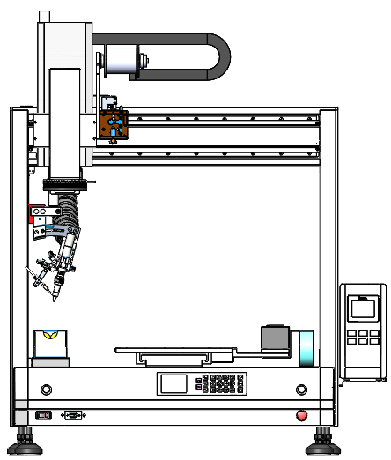
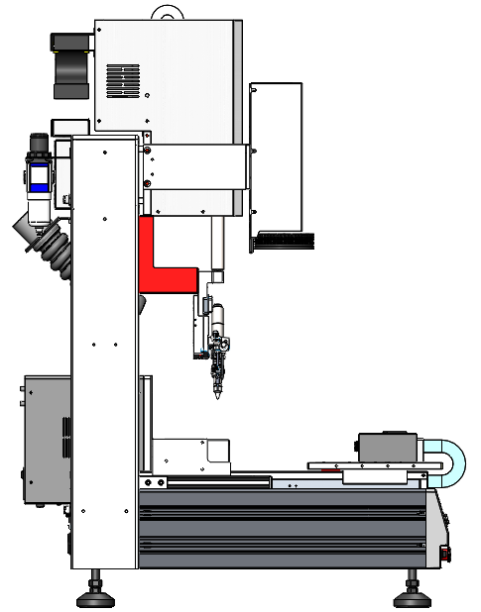
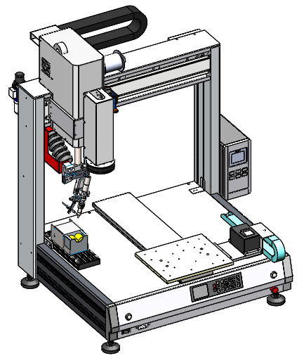
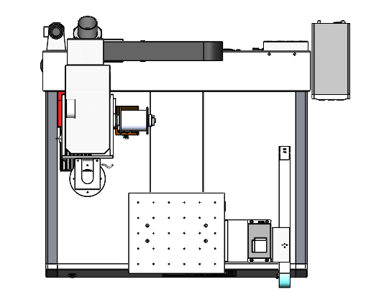
Dimensions Diagram
01
920mm
100mm
225mm
700mm
Note:
The size of the equipment is only the reference size of the scheme, and the actual size shall prevail after optimization
690mm
Distance between the middle of fiducial camera and front panel is around 250mm

Slide 5
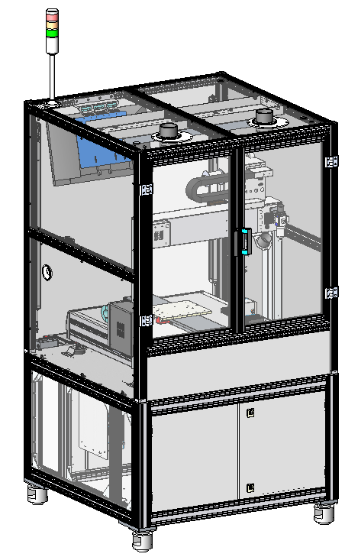
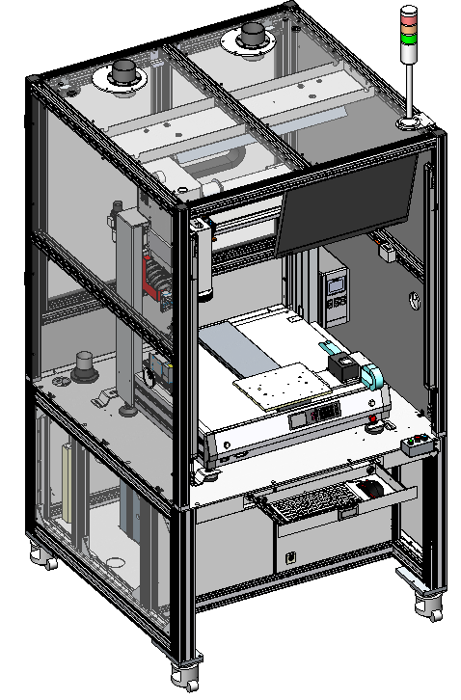
Descriptions
02
Transparent ESD acrylic plate
Back safety door
LED Light
Tower light
Fume hood
Monitor
Transparent ESD acrylic plate
Curtain sensor
Fume hood
Keybox
Fume extractor
Mouse & Keyboard
Built-in Industrial PC
Sheet metal rear sealing plate

Slide 6
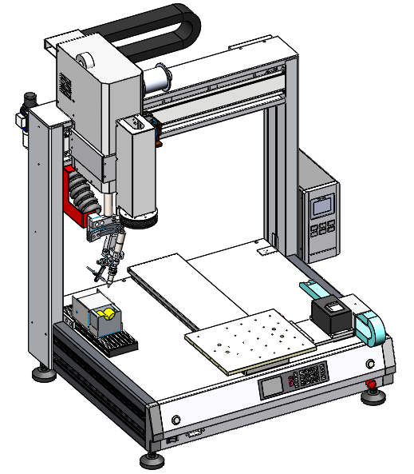
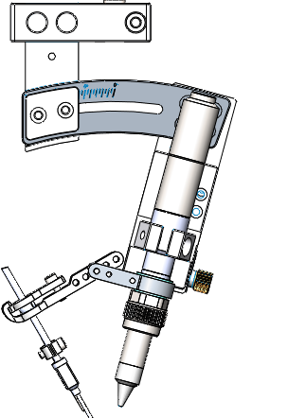
Descriptions
02
371TAA Self-feeder
ZR Axes
X Axis
Bent frame assembly (15°)
Oil-water separator
Heating controller
9018M Soldering iron
Fiducial camera
Fume hose
Feeding tube fixture
Y Axis
QUICK9036 Tip position correction device
Movement range:
X Axis=500mm
Y Axis=500mm
Z Axis=100mm
R Axis=±180°
QUICK310C Tip cleaner

Slide 7



Thanks
FIND OUT MORE ON QUICK-GLOBAL.COM

