Slide 2
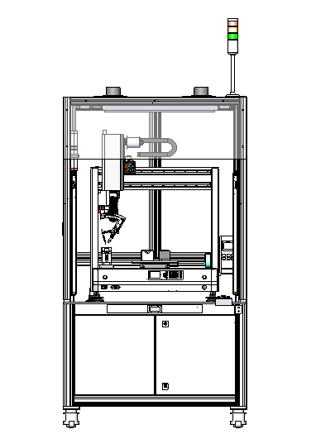
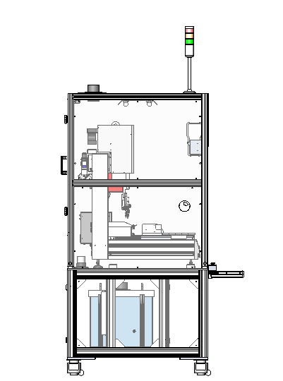
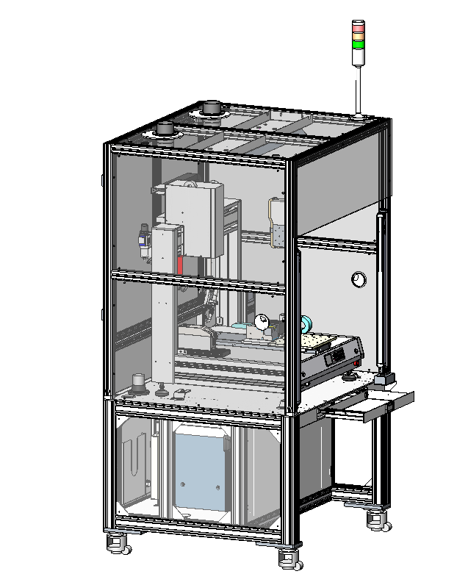
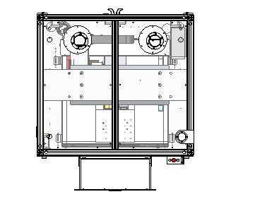
Dimensions Diagram
01
675mm
1800mm
950mm
720mm
1000mm
Note:
The size of the equipment is only the reference size of the scheme, and the actual size shall prevail after optimization
900mm

Slide 3
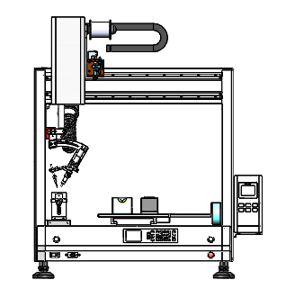
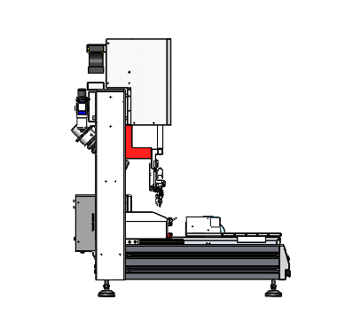
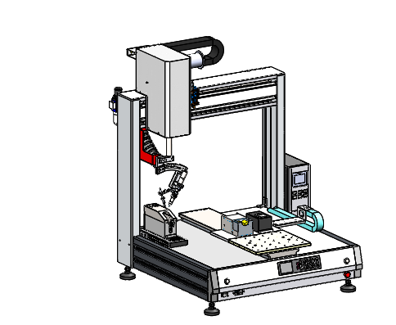
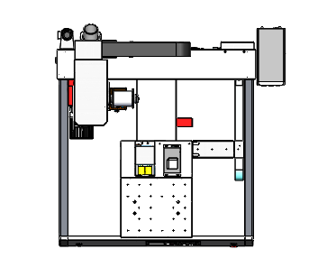
Dimensions Diagram
01
900mm
100mm
225mm
700mm
Note:
The size of the equipment is only the reference size of the scheme, and the actual size shall prevail after optimization
600mm

Slide 4
Descriptions
02
Transparent ESD acrylic plate
LED Light
Tower light
Fume hood
Transparent ESD acrylic plate
Teaching pendant
Light curtain
Fume hood
Transparent ESD acrylic plate
Fume hood
8031HA Key box
QUICK6101A1 Fume extractor

Slide 5
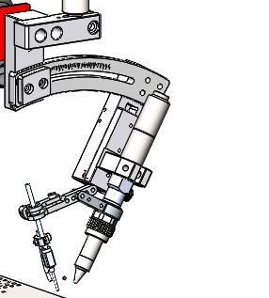
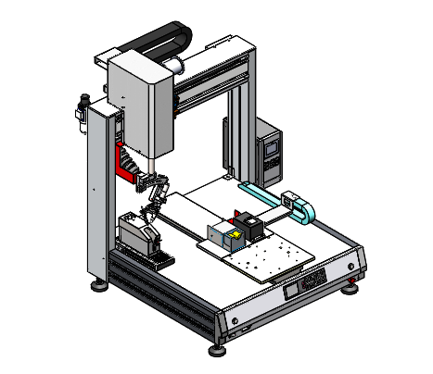
Descriptions
02
371TAA Self-feeder
Bent frame assembly
ZR Axis
X Axis
Oil-water separator
Soldering iron
Fume hose
378FA heating controller
QUICK310C Tip cleaner
9036 Tip position correction device
Feeding tube fixture
9026GE slag box
Y Axis
Movement range:
X Axis=500mm
Y Axis=500mm
Z Axis=100mm
R Axis=360°

Slide 6



Thanks
FIND OUT MORE ON QUICK-GLOBAL.COM

